Slide 1


Perfect parking
By Rhys quilter
Available at https://github.com/rhys-lit/perfect-parking-fyp

Slide 2
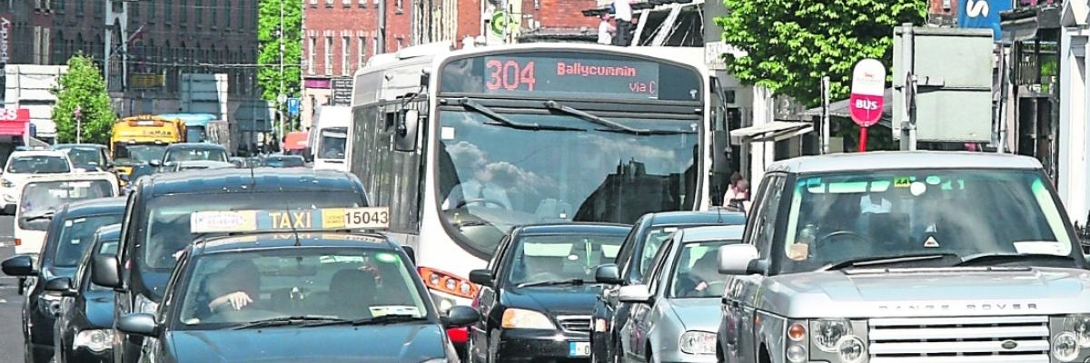
Introduction
To provide a central database of all parking spaces in a city
To determine the status of the parking spots i.e., free or occupied.
To reduce the time motorists spend looking for parking in cities.

Slide 3
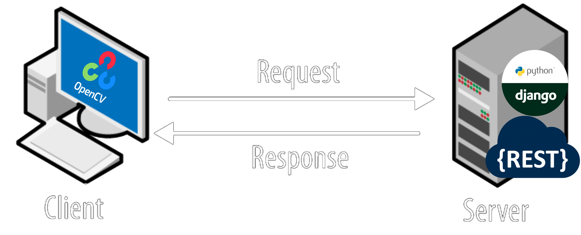
Client – Server Architecture
Notes:
Talk about the technologies: Open CV and Django
A lot an AI development is done in a Python
Server is a website, built upon Django/Python for Users
Server has a REST API for the Parking Monitor Client Apps to update the Server
Parking Monitor Client App uses OpenCV to determine if space is free. (using olgarose)

Slide 4
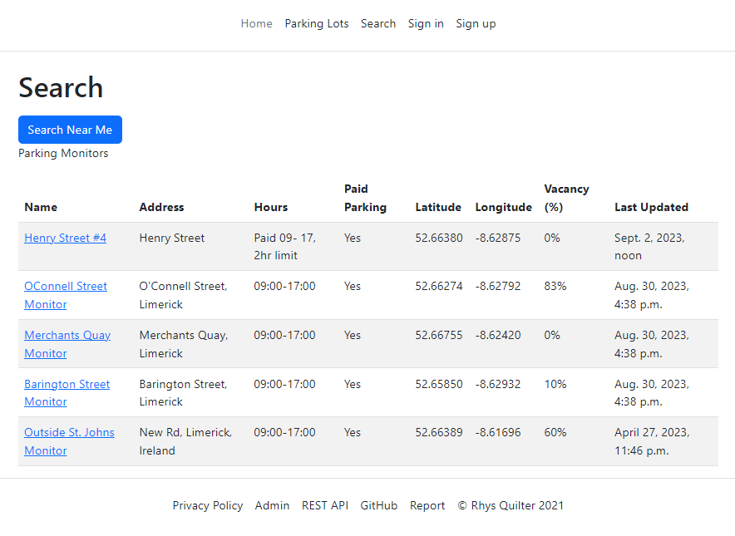
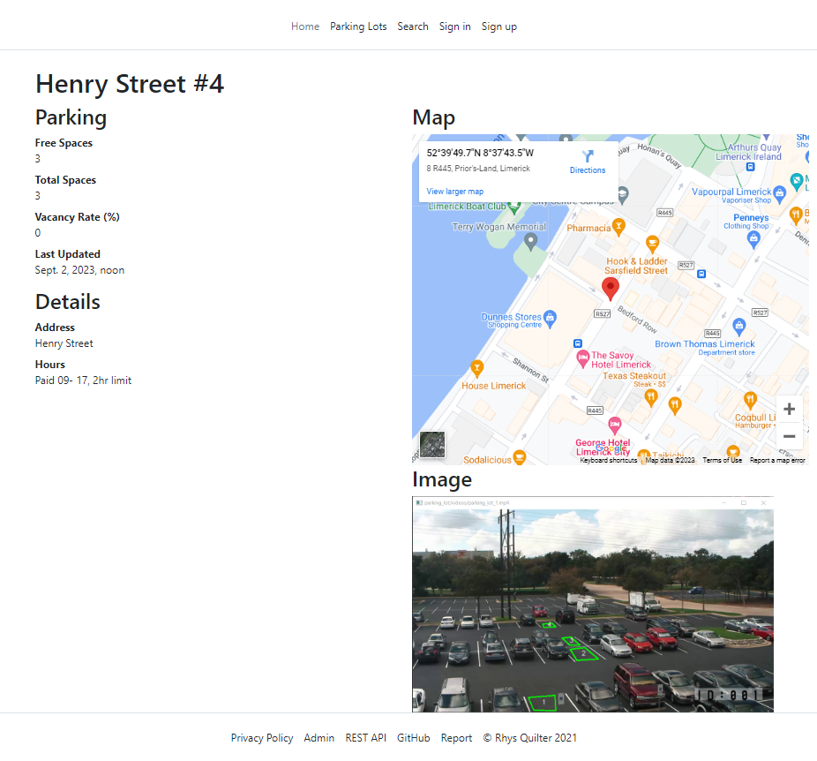
Perfect Parking Website
Notes:
The Website,
You can see the parking monitor data (parking availability) and with some JavaScript your distance to the parking lot
You can see full details (drill-down) of any parking monitor . Use google maps to get directions. You have an image of the parking lot.
In future releases you want to upload a current pic of the parking lot.
http://127.0.0.1:8000/parking-lot-monitors

Slide 5
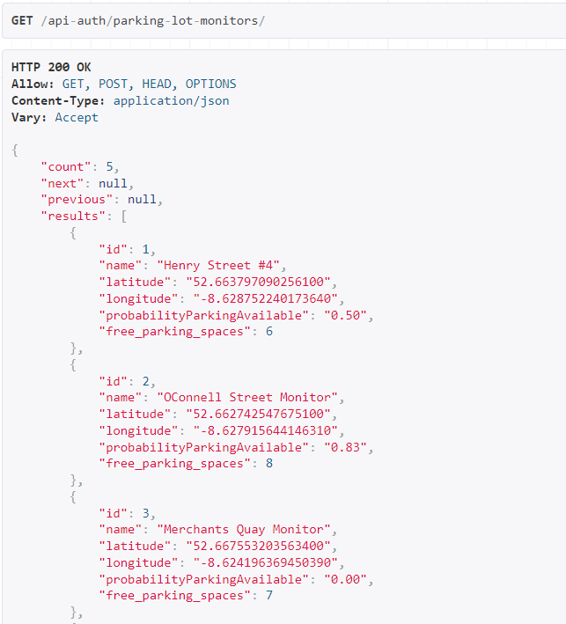
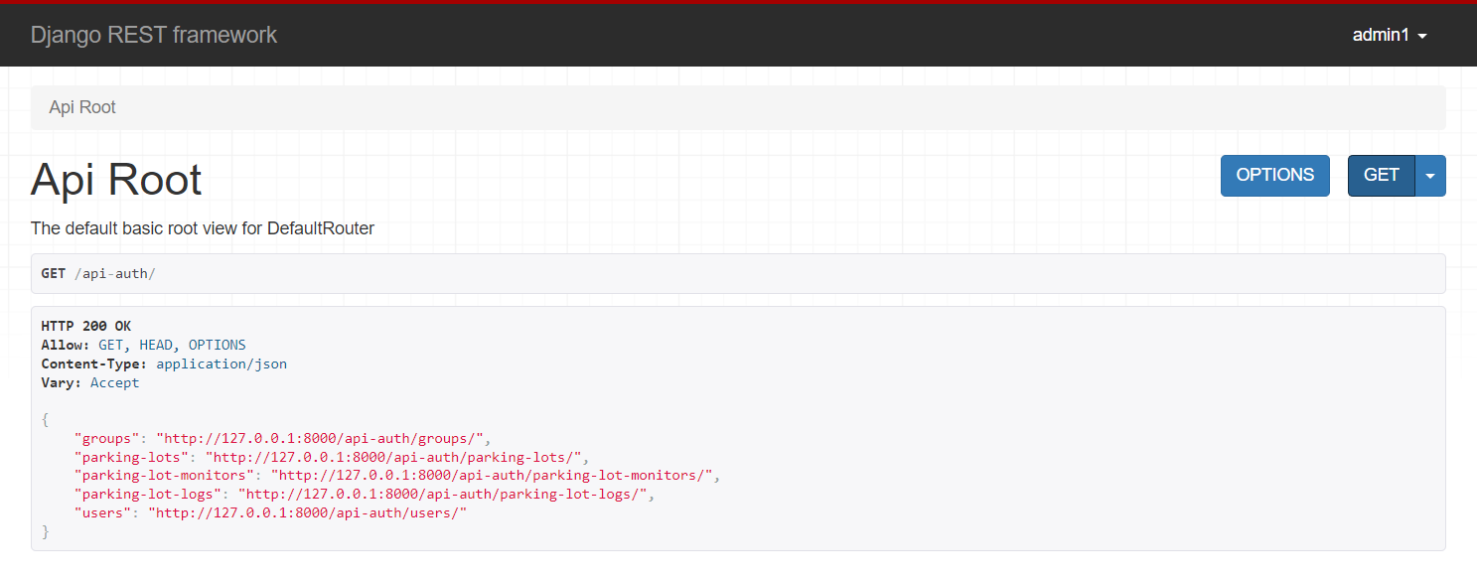
Perfect Parking REST API

Slide 6
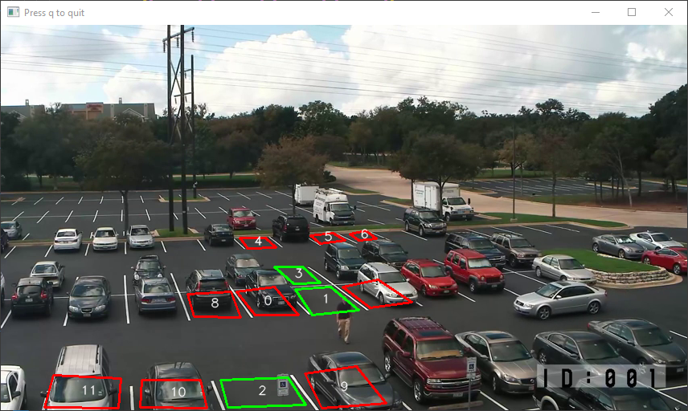
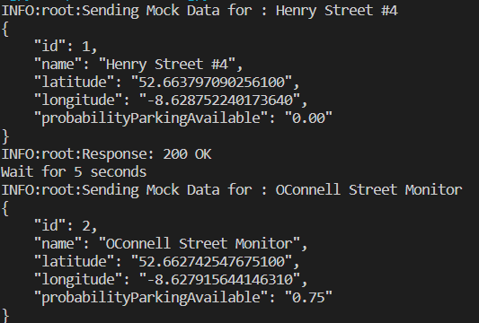
Perfect Parking (Client)
Client
Mock Client
Notes:
I have the clients one real and one with mock data.
On the left , the real client
The real client takes data from a pre recorded video source.
In this image we can see three spots are vacant and one is occupied
On the right the mock client
The mock sends random parking data put requests to the server at random times

Slide 7
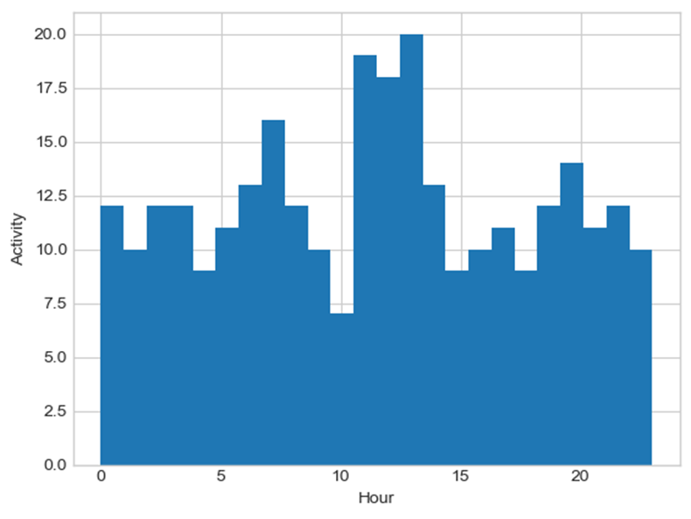
Data collection
While Building Perfect Parking I came to realise the importance of gathering data from parking lots to optimize operations and user experience in the future.
Data Collection Process:
The data is collected from the Parking Lot Monitor
The monitors wait for a change in occupancy in the carpark.
When there is a change, the data is collected and gets stored in the database.
Why collecting data is important:
Provides insights for parking lot operators to optimize space.
Enables historical analysis for better planning

Slide 8



Thank You
Any Questions?

